Slide 1
Normalization of Databases
By Krishnan Ramakrishnan
Senior Presentation (Jul 2017)
San Francisco State University

Slide 2
Outline
Introduction
First Normal Form
Second Normal Form
Third Normal Form
Conclusion

Slide 3
Introduction
Database normalization is a process of transforming a data model in such a way that performs and scales a physical implementation
The main objective of normalization is as follows:
Eliminates redundancy of data elements (Storage efficiency)
Eliminates or reduces data anomalies
Enables efficient scaling of application functionality
Database normalization was first proposed by Edgar F. Codd.
In order to do normalization, we must understand the requirements in order to normalize a table.
Database normalization is progressive. That is, in order to have a 3rd normal form, we must have a 2nd normal form and to have a 2nd normal form, we must have a 1st normal form.

Slide 4
Introduction (Ctd.)
Redundancy:
The normalized design will ensure that the same data element is stored only once in one of the tables.
Example: An employee’s first and last name can only be stored in the employee table and nowhere else
This will also result in an efficiency in space usage.
Anomaly:
There are 3 types of anomalies: Insert, Update, and Delete
An insert anomaly occurs when some information cannot be inserted without the presence of others.
An update anomaly occurs when one or more instances of duplicated data are updated.
A delete anomaly occurs when certain attributes are lost due to the deletion of other attributes.

Slide 5
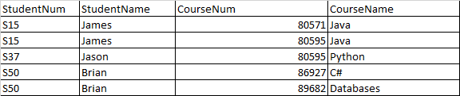
Introduction (Ctd.)
Student-Course Table
Here, CourseName and StudentName are redundantly stored.
Both student names and course names can be inconsistent across various records.
New courses cannot be inserted unless a student is enrolled in it.
New students cannot be entered unless they are enrolled in a course.
Courses of students cannot be deleted without deleting the courses itself.

Slide 6
Outline
Introduction
First Normal Form
Second Normal Form
Third Normal Form
Conclusion

Slide 7
First Normal Form
In a relational database, an object is in first normal form if and only if it satisfies the following conditions:
Three rules of first normal form:
Each table must contain a Primary Key that uniquely identifies each row in a table.
Values in each column has to be atomic, meaning one column cannot have multiple values.
There cannot be any repeating groups of attributes.
If the above conditions are satisfied, the tables are considered to be in first normal form

Slide 8
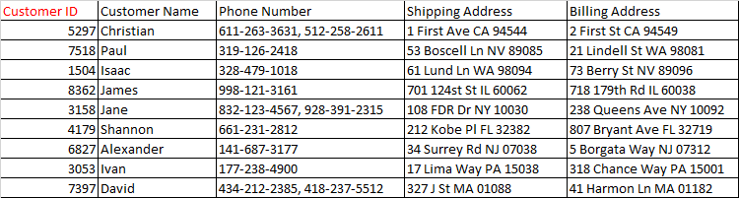
First Normal Form - 1
Original Table:
This table is not normalized:
Multi-value violation: The phone number column violates this rule.
Both the Shipping Address and Billing Address columns violate repeating group rules.
At present, there is no Primary Key violation.

Slide 9
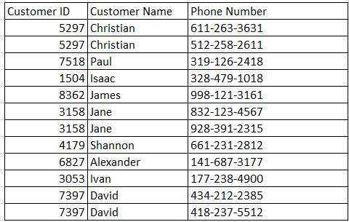
First Normal Form - 2
Step 1: Normalizing multi-value columns.
Multi-column value violations is addressed by normalizing each of the values in the multi-column into a separate row along with the rest of the attributes.
The multi-value column violation has been fixed, however, we see that it has led to a Primary Key violation. We will resolve this in the next step.

Slide 10
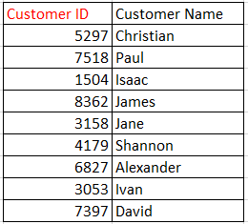
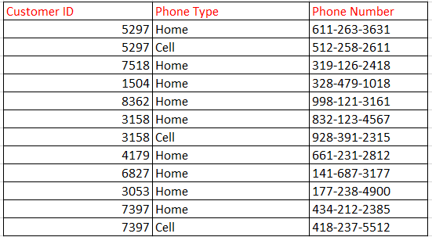
First Normal Form – 3
Step 1 (Ctd.): The Primary Key violation is resolved by removing the phone numbers to a separate table.
Customer Table Customer-Phone Table
The Primary Key violation of the Customer table has been resolved.
We can now see that there’s no constraint on defining any number of phone numbers for a given customer.

Slide 11
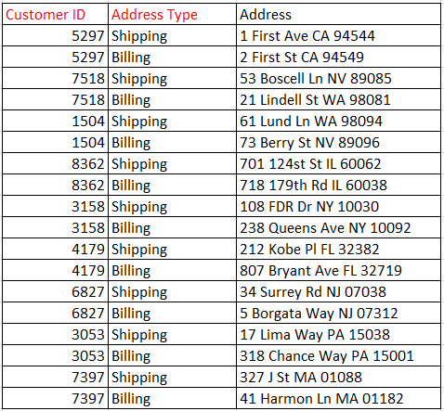
First Normal Form - 4
Step 2: Take the repeating groups of elements and put it into a separate table to resolve the repeating group violation on Address
Customer-Address Table
We apply a similar logic to Step 1 to eliminate repeating groups of Billing and Shipping Addresses
We have a one-to-many relationships in the Customer-Phone table, because 1 customer can have multiple phone numbers.
Similar to the Customer-Phone table, we can clearly see the advantages of keeping the addresses organized in a separate table.

Slide 12
First Normal Form - 5
Customer Table Customer-Phone Table Customer-Address Table
Now, the original data is in first normal form, each table satisfies all 3 conditions.

Slide 13
Outline
Introduction
First Normal Form
Second Normal Form
Third Normal Form
Conclusion

Slide 14
Second Normal Form
The second normal form defines the rules of attribute dependence on the Primary Key. Data is suppose to be in the second normal form if it satisfies the following conditions:
The table must be in first normal form.
All Non-Key attributes are fully functional dependent on each element of the primary key.
All attributes that make up the Primary Key are called key attributes. The rest of the attributes are called Non-Key attributes.
The second level of normalization is also known as key dependency

Slide 15
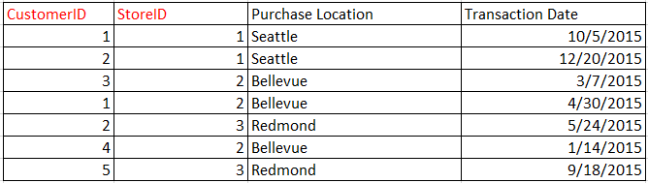
Second Normal Form (Example)
In this table, both CustomerID and StoreID are the Primary Key.
The Non-Key attribute is Purchase Location which depends on StoreID that is only part of the Primary Key and violates the second normal form.
The transaction date is dependent upon both CustomerID and StoreID and is in the second normal form.

Slide 16
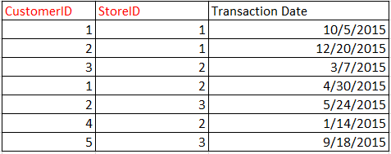

Second Normal Form (Example)
Converting data to second normal form:
Table Purchase Table Store
We take the violating location name and create a separate table containing both the store location and StoreID.
Now, the original data is in second normal form, each table satisfies the two conditions.

Slide 17
Outline
Introduction
First Normal Form
Second Normal Form
Third Normal Form
Conclusion

Slide 18
Third Normal Form
The third normal form defines the rules of transitive functional dependency. Data is suppose to be in the third normal form if it satisfies the following conditions:
The table must be in second normal form
There doesn’t exist a transitive functional dependency between any of the attributes in the table. Simply put, no two Non-Key attributes can have a dependency.

Slide 19
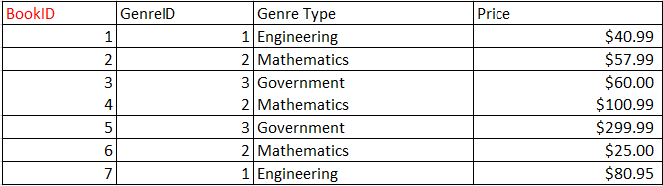
Third Normal Form (Example)
The Primary Key of this table is BookID.
The GenreID qualifies the BookID and is dependent on BookID.
Price is also dependent on BookID
However, the GenreType is dependent on only the GenreID which happens to be a Non-Key attribute.
Moreover, this is a transitive dependency that violates the third normal form.

Slide 20
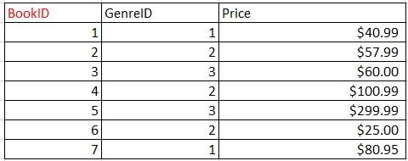

Third Normal Form (Example)
How do we normalize the table using a 3NF?
Table Book Table Genre
As the GenreType has a transitive dependency violation, we separate that to a separate table.
Now, both tables are in third normal form.

Slide 21
Outline
Introduction
First Normal Form
Second Normal Form
Third Normal Form
Conclusion

Slide 22
Conclusion
We have seen how database normalization can decrease redundancy, increase efficiency, and reduce anomalies.
It is extremely important for any relational database design to conform to the basic normalization rules.
Relational database designs that have not been optimally normalized has often ran into issues on scalability, performance, and storage.

Slide 23
References Used
http://www.1keydata.com/database-normalization/second-normal-form-1nf.php
http://www.1keydata.com/database-normalization/second-normal-form-2nf.php
http://www.1keydata.com/database-normalization/second-normal-form-3nf.php
https://www.sqa.org.uk/e-learning/MDBS01CD/page_24.htm
https://www.sqa.org.uk/e-learning/MDBS01CD/page_22.htm
https://www.sqa.org.uk/e-learning/MDBS01CD/page_23.htm

